Slide 1
Live Project: Transformer Trip
Team:
 | Gary Cheng – garychengkl@gmail.com Santosh - santnair0599@gmail.com Celia Selvakumari -celiaselvakumari@gmail.com Wan Muhamad Taufik Wan Ahmad - taufikwanahmad@gmail.com, Lee Cheong Loong - cheongloong@gmail.com

Slide 2
BUSINESS OBJECTIVE:
To classify root causes of the transformer trip and also identify the strong parameters which are associated with transformer tripping.
Agenda to Achieve Goal
To Understand the Business Problem
Identify the variable which are relevant to our business problem
Collect Public available data or Synthesized data
Exploratory data Analysis (EDA)
Build Algorithms
Then based on the accuracy Shortlist the better Algorithms
Tune the hyper parameter in Final model
Then visualize the prediction result’s in Tableau

Slide 3
Transformer Trip Root causes
Classifying root causes for a transformer trip

Slide 4
Causes for a transformer trip
A transformer’s circuit breaker or a protection relay trips when there is sudden voltage surge or a high current passing through. The breakers trips to avoid further damage to the transformer under these extreme conditions.
Usually a transformer trip is caused by external factors like extreme weather conditions and can be resolved in a day or two.
Operational and environmental data that causes a trip are, Load, Ambient Temperature and oil temperature
Transformer condition related data can be dissolved gases, moisture, capacity etc.

Slide 5
Business Objective
Our aim is to classify the root causes for a transformer trip.
A classification model should be built that can correctly identify the root cause when we provide the input parameter values.
To accomplish this, we have to identify few of the major root causes and input parameters that contribute for causing that defect.

Slide 6
1. Lightening Surge
When lightening strikes on a transformer or the power lines, an electrical surge is created. This high voltage can cause high currents to flow, which will trip the breaker in transformer.
Also, heavy winds can cause tree branches to fall on power lines causing short circuit and the circuit breaker trips.
Input parameters for lightening surge trip are
Highly prone to lightening and rainfall
Wind speed more than 45 mph

Slide 7
2. Overload
When the load to a transformer becomes more than the installed capacity of the transformer, breaker can trip due to overload.
Input parameters are,
Installation capacity
Load of the transformer greater than the capacity
Age – Old transformers may not provide the increasing power demand

Slide 8
3. Oil Leakage/Cooling system Failure
Oil leakage caused reduced oil quantity and affects the cooling for the transformer. This in turn increases the temperature inside the transformer and damages the vital parts. Higher temperatures inside can cause the transformer to trip.
Input parameters are,
High humidity, high rainfall locations
Presence of corrosive sulphur in cooling oil
Low maintenance
Age – Old transformers can be prone to corrosion and leakges

Slide 9
4. Insulation deterioration
This type of trip is caused by thermal degradation over the life of transformer, excessive or frequent fault current and high voltage stress.
Input parameters are,
Age – old transformers are prone to deterioration
Poor maintenance
Ambient Temperature – more than 40C
Oil temperature – more than 105C
Winding Temperature – more than 110C

Slide 10
5. Dissolved gases in oil
When the concentration of dissolved gases in transformer oil is above the allowed limit, it can cause corona, Arcing and overheating. This will in turn result in transformer trip.
Input parameters are,
Poor maintenance
Hydrogen – more than 1000
CO – more than 1000
CO2 – more than 15000

Slide 11
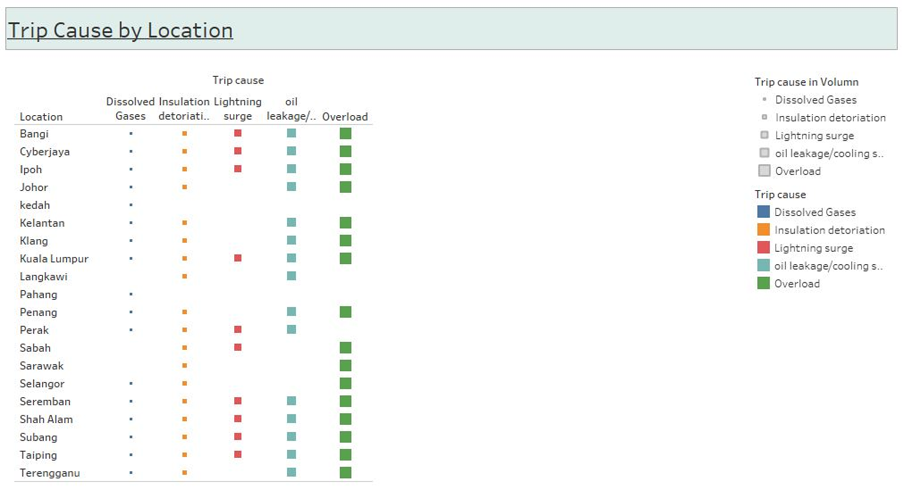

Slide 12
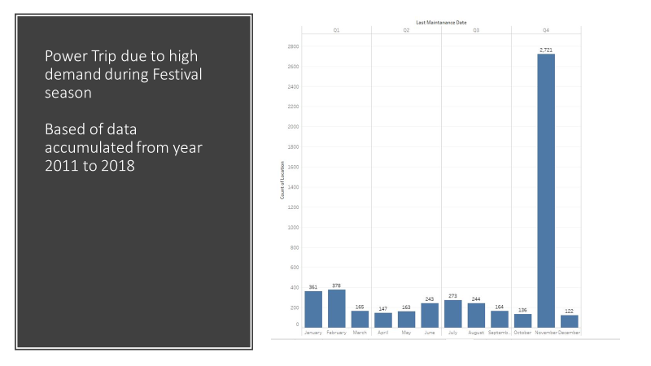

Slide 13
Clustering on Transformer Trip Data

Slide 14
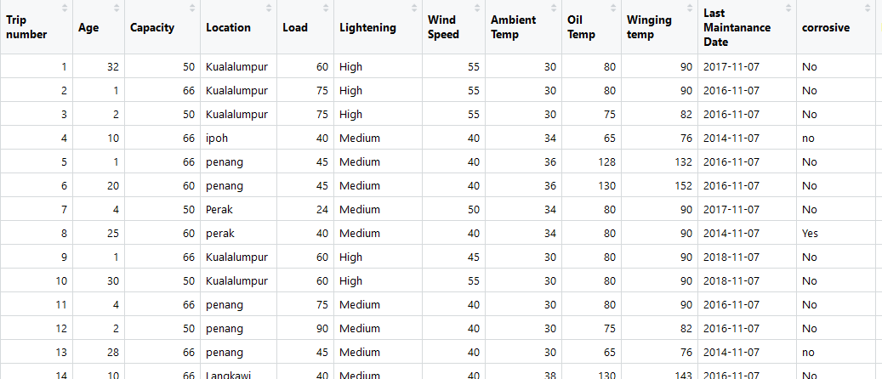
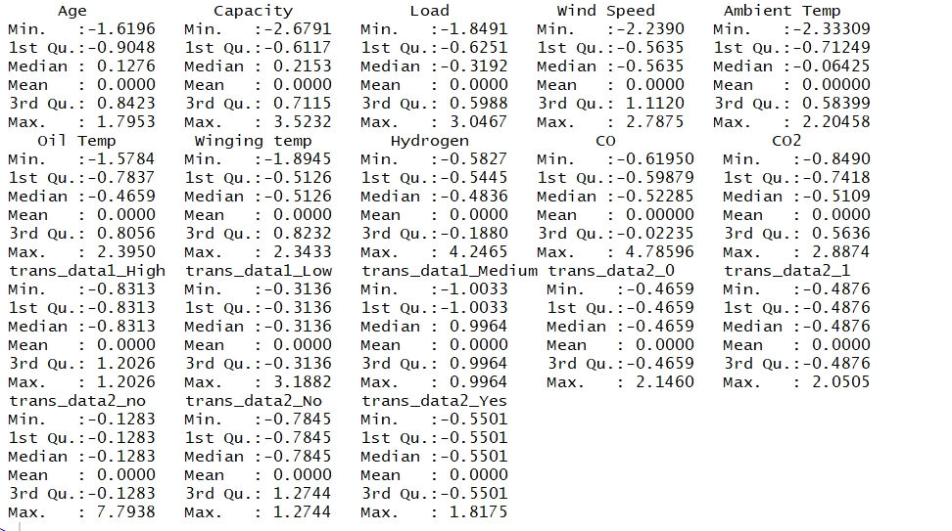
Transformer Trip Dataset
The dataset has 4076 observations and 17 variables.
We need to normalize the variables so that it becomes unit free and scale free

Slide 15
Creating Euclidean Distance Matrix
d <- dist(normalize_data, method="euclidean")
Calculating the distances using Euclidean Matrix
Clustering based on Distance using Complete linkage method
fit <- hclust(d, method="complete")

Slide 16
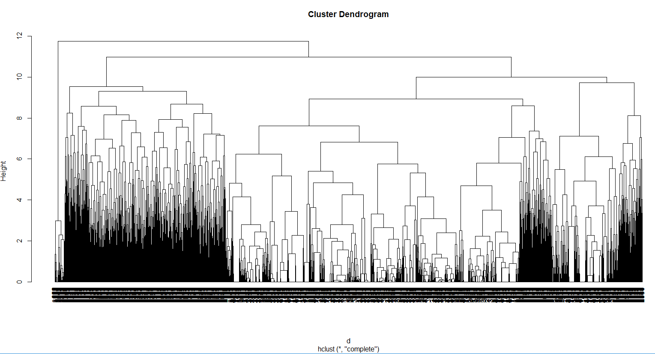
Dendrogram

Slide 17
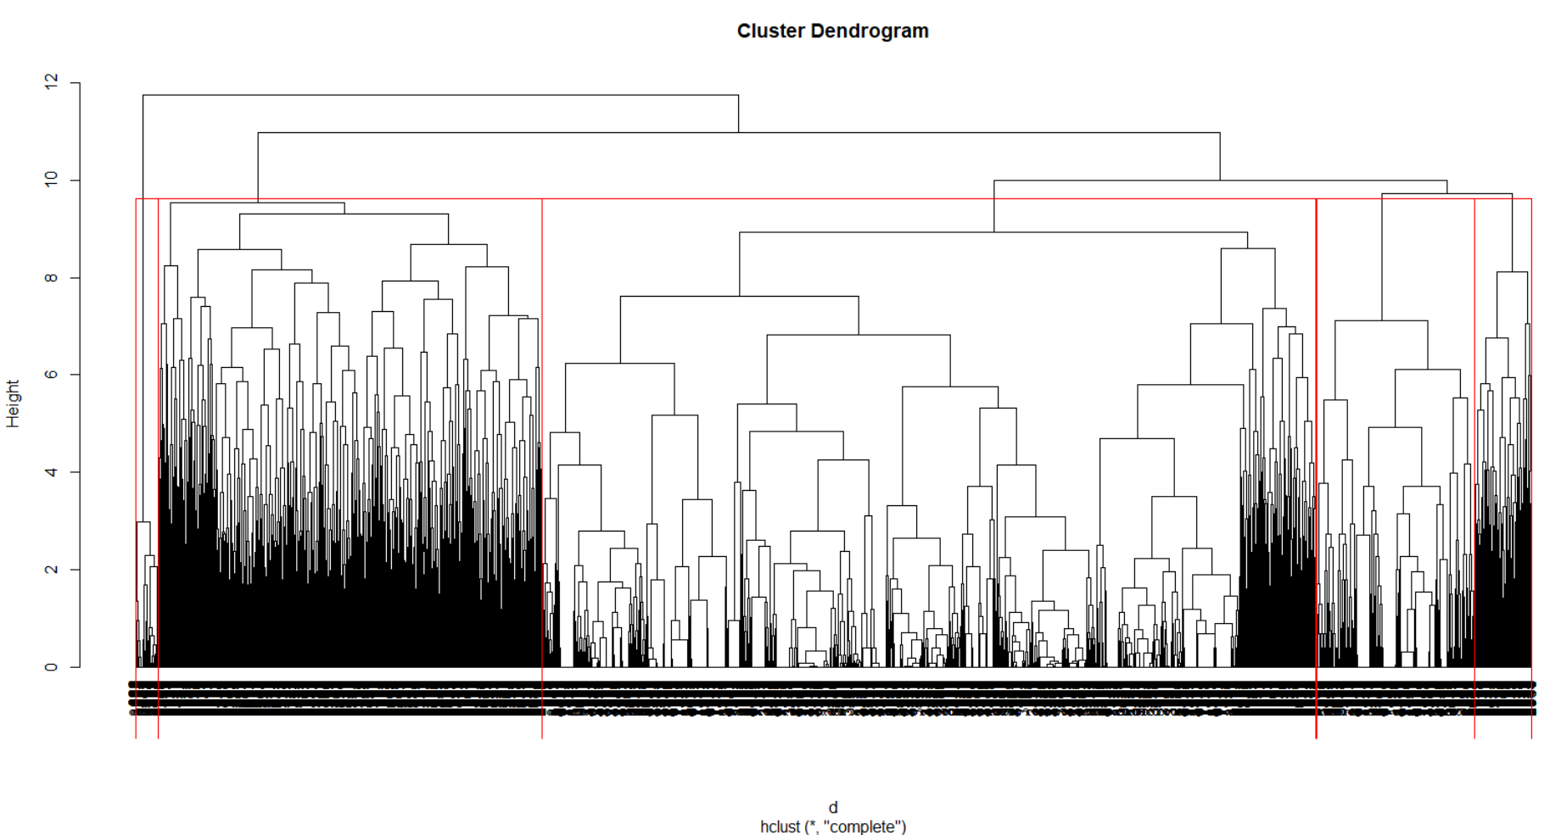
Dendrogram with 5 Clusters
There are no variables with high VIF

Slide 18
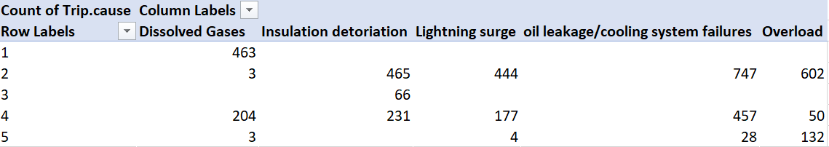
Final Analysis of Clusters

Slide 19
K means Clustering on Transformer Trip Data

Slide 20
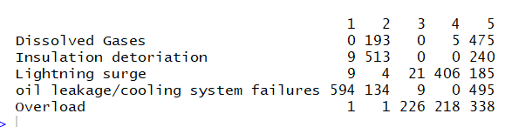
Cross Table to compare original Trip Cause with the 5 clusters

Slide 21
Principal Component Analysis on Transformer Trip Data

Slide 22
Transformer Trip Dataset
The dataset has 4076 observations and 17 variables.

Slide 23
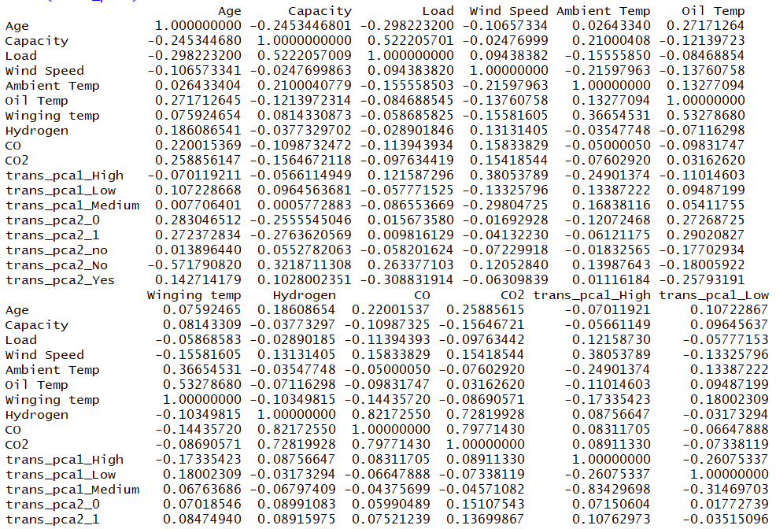
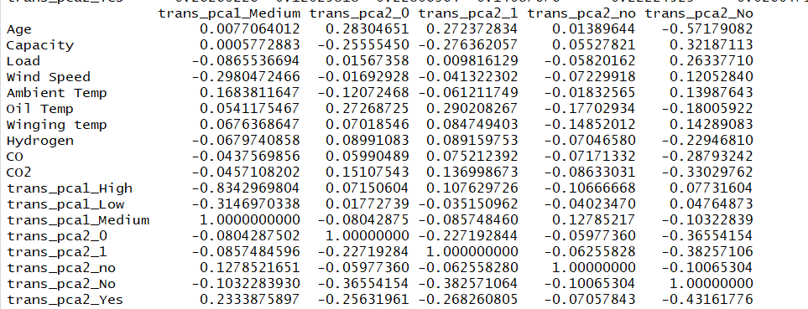
Correlation Matrix

Slide 24
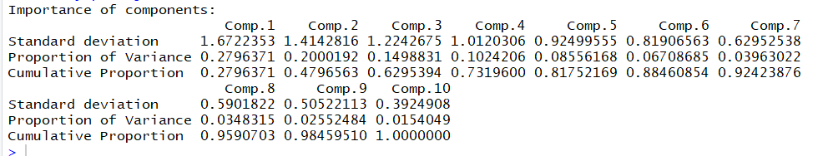
Summary of Principal Component
The first PC is capturing 28%
The second PC is capturing 20%
The third PC is capturing 15%
The fourth PC is capturing 10%
The fifth PC is capturing 8.5%
The sixth PC is capturing 6.7%
Together all 7 PCs are capturing 88%

Slide 25
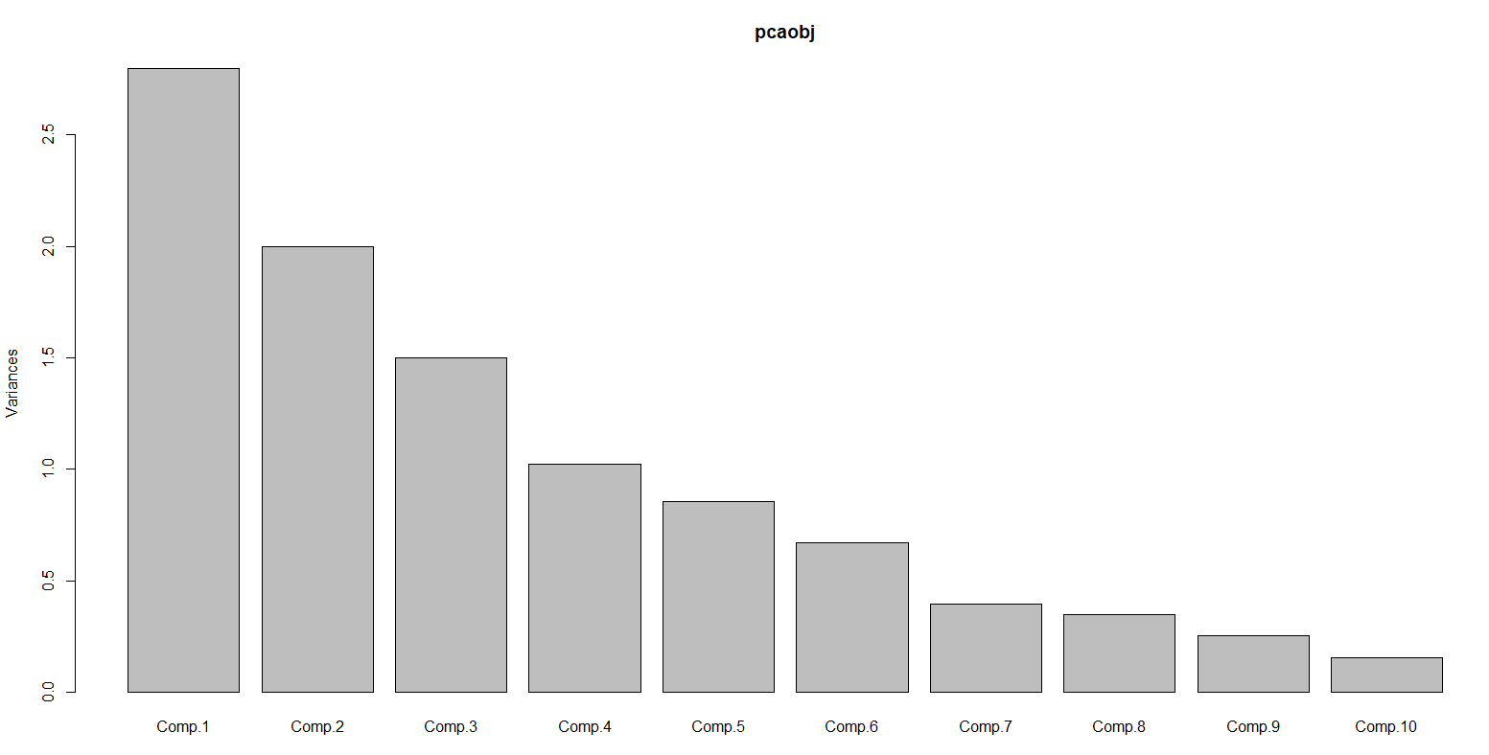
Plotting Principal Components
The first PC has highest variance followed by second and third.

Slide 26
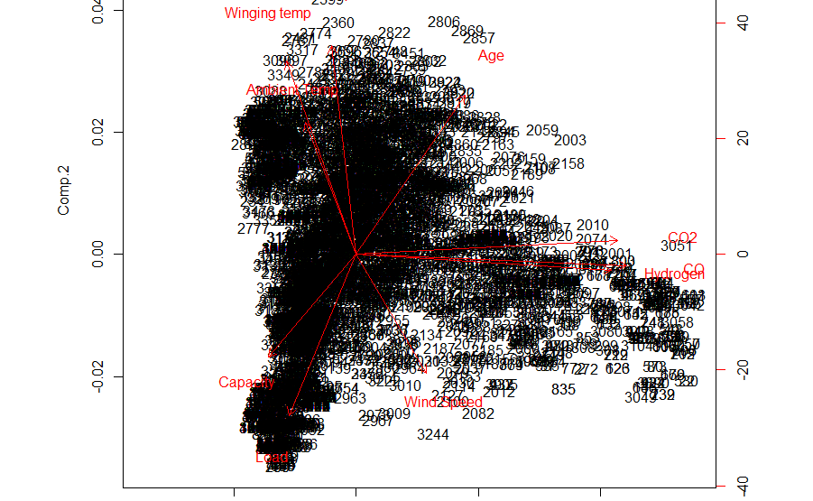
Biplot of Principal Components

Slide 27
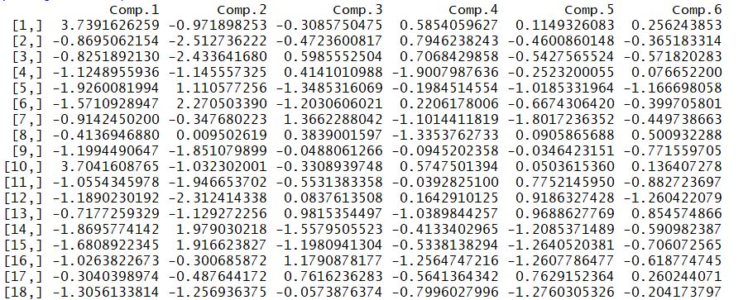
Principal Component Scores
Scores of first 6 components are generated and this is added to the transformer trip dataset

Slide 28
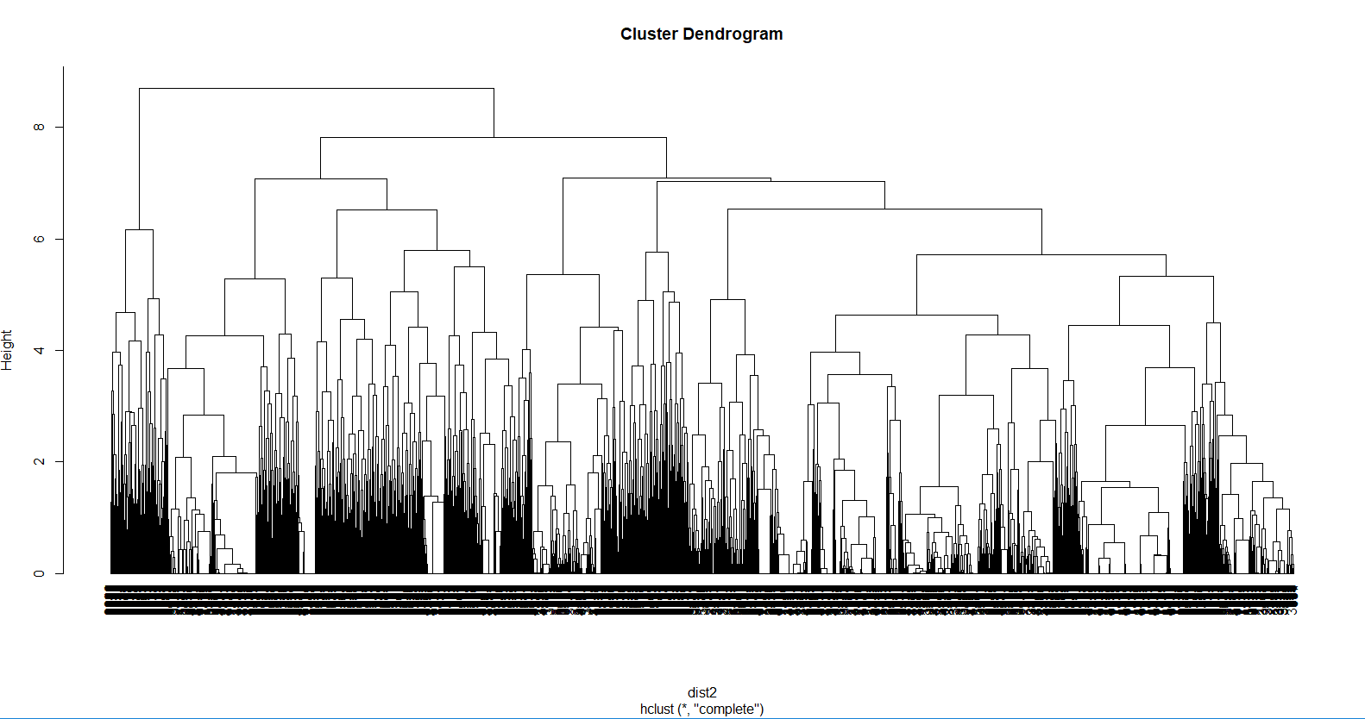
Hierarchical Clustering - Dendrogram
We can make 5 clusters

Slide 29
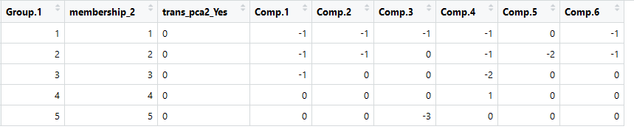
Aggregate of clusters
5 clusters and the aggregate values are displayed

